Slide 1

PLAY AND LEARN​
Stanislava Andonova, Kristina Bolashikova, Zhenya Yordanova ,Yavor Karakolev
Vocational School for Computer Programming and Innovations​

Slide 2
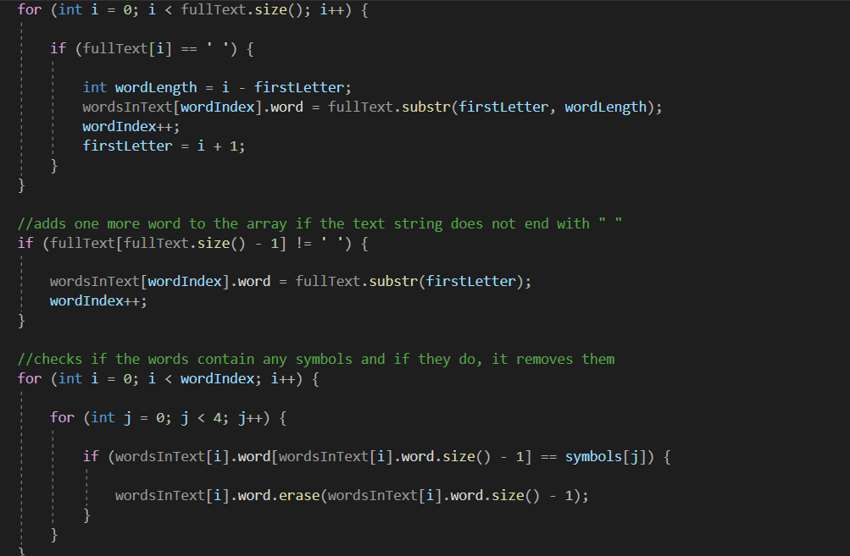
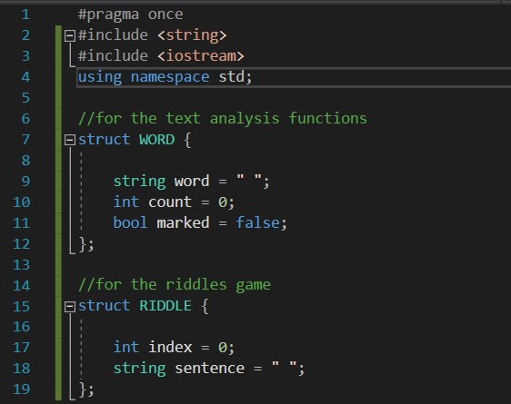
Summary
Description of the application

Slide 3
Milestones in the realization

Slide 4

Deciding what to do
01
Discussing ideas
02
Working on the code
03
Testing
04

Slide 5






Used resources

Slide 6
Conclusion

Slide 7
Q&A

Slide 8
Thanks for your
attention!

